Slide 1
Lean Coffee
Georgia GMIS 2019 Fall Conference

Slide 2
Lean Coffee Lives Here

Slide 3
What is Lean Coffee?
Lean Coffee is a structured, but agenda-less meeting. Participants gather, build an agenda, and begin talking. Conversations are directed and productive because the agenda for the meeting was democratically generated.

Slide 4
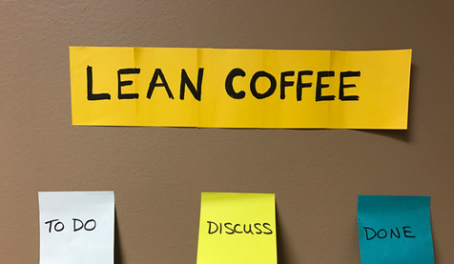
Set the stage
A Kanban board is a work and workflow visualization tool that enables you to optimize the flow of your work.

Slide 5
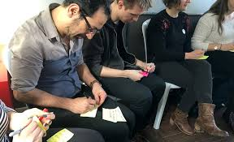
Discover topics
Write all topic ideas on post-it notes, one topic per post-it.

Slide 6
Introduce ideas
Pitch each topic in 1-2 sentences. 10 second limit!

Slide 7
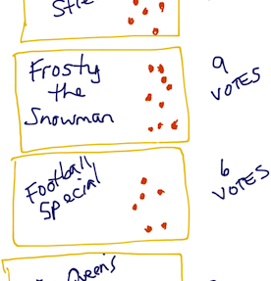
Dot vote
Each participant gets two votes. You can vote twice for the same thing or for two different topics. Simple put a dot on the sticky you are interested in. Tally the dots.

Slide 8
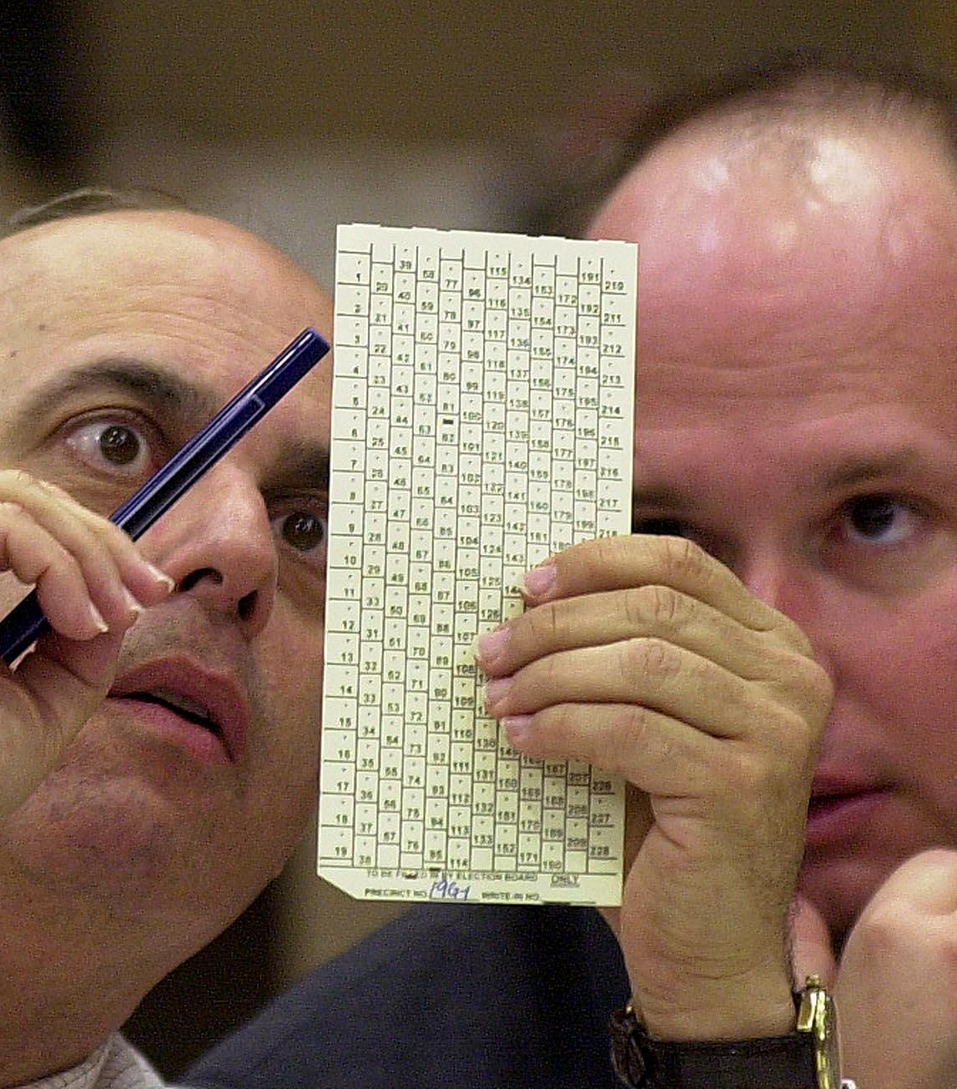
Sort the votes
Topics with the most dots go at the top; least at the bottom.

Slide 9
Facilitate discussion
Pick the first topic and start a 7-minute timer for group discussion.

Slide 10
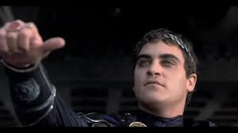
Hold a Roman vote
After 7 minutes, vote to continue or to kill the discussion. Majority rules!

Slide 11
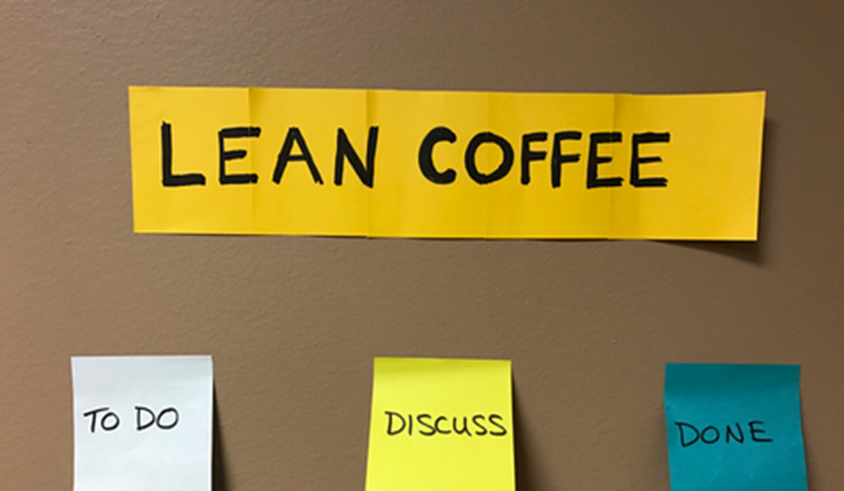
Go to the next topic
Move on to the next topic until you’ve flowed through the Kanban board or used up your time.

Slide 12
Sum up and improve
Did you like the format?
Was the balance between the number of topics and the time allocation good?
Would you prefer more topics or longer discussions?
What will you do better next time?

Slide 13
Lean Coffee Lives Here

Slide 14
Lean Coffee
Georgia GMIS 2019 Fall Conference

